Slide 1
Lecture 6: Naïve Bayes and NLP
Er.Roshan Shrestha
roshan.shrestha@islingtoncollege.edu.np

Slide 2
Outline
Naïve Bayes Classifier
Setting
Example
NLP

Slide 3
Naïve Bayes Classifier
is a popular supervised machine learning algorithm used for classification tasks such as text classification.
belongs to the family of generative learning algorithms, which means that it models the distribution of inputs for a given class or category.
Bayes’ theorem is based on the probability of a hypothesis, given the data and some prior knowledge.
The naive Bayes classifier assumes that all features in the input data are independent of each other, which is often not true in real-world scenarios.
This "naive" assumption simplifies the calculations, making the algorithm computationally efficient.

Slide 4
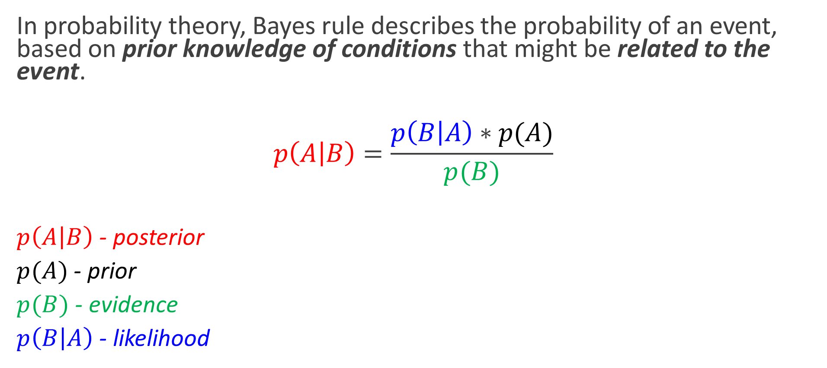
Bayes Rule
In probability theory, Bayes rule describes the probability of an event, based on prior knowledge of conditions that might be related to the event.
$$p\left(A | B\right)=\frac{p\left(B | A\right)∗p(A)}{p(B)}$$
$p\left(A | B\right)$ - posterior
$p(A)$ - prior
$p(B)$ - evidence
$p\left(B | A\right)$ - likelihood

Slide 5
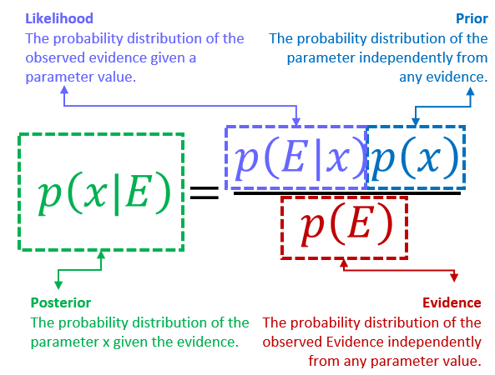

Slide 6
At the heart of the Naive Bayes algorithm lies Bayes' Theorem, serving as the backbone of probabilistic modeling.
Bayes' Theorem is like a secret decoder for probability problems.
It helps us find the probability of an event (let’s say A) happening when we know the probability of another event (B) happening.

Slide 7
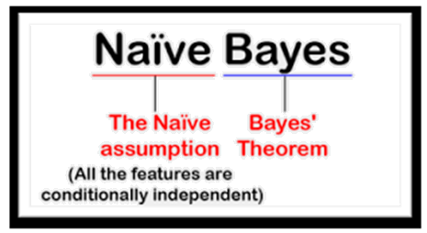
Why naïve?
This simplification helps Naive Bayes work fast and well.
Assumption of feature independence reduces the immense computational burden of considering all possible interactions between features.
makes it computationally efficient and works well when this independence assumption isn't severely violated in the data.
Despite this simplifying assumption, the naive Bayes classifier is widely used because of its efficiency and good performance

Slide 8
Types of Naïve Bayes Classifier
Gaussian Naive Bayes:
Assumes that numerical features follow a Gaussian (normal) distribution.
Likelihood is computed using the probability density function of the Gaussian distribution.
Multinomial Naive Bayes:
Used for discrete data like text classification (e.g., spam detection).
Likelihood is based on the frequency of features.
Bernoulli Naive Bayes:
Used for binary data.
Features are binary (e.g., word presence or absence in a document).
Gaussian Naive Bayes
Multinomial Naive Bayes
Bernoulli Naive Bayes

Slide 9
Applications
Spam filtering
Text classification
Sentiment analysis
Recommender systems
Advantages:
Fast and Efficient:
Works well with large datasets and high-dimensional data.
Easy to Implement:
Requires fewer computational resources.
Handles Multi-Class Problems:
Can classify into multiple categories effectively.
Works Well for Text Data:
Widely used for spam filtering, sentiment analysis, and document classification.
Disadvantages:
Strong Independence Assumption:
features independent(often not true in real-world data)
Poor Performance with Correlated Features:
Overestimates or underestimates probabilities
Sensitivity to Zero Probabilities:
If a feature's likelihood is zero for a class, the entire product becomes zero. (Laplace Smoothing.used)

Slide 10

Bayes Rule
2 machines in a factory produce wrenches

Slide 11
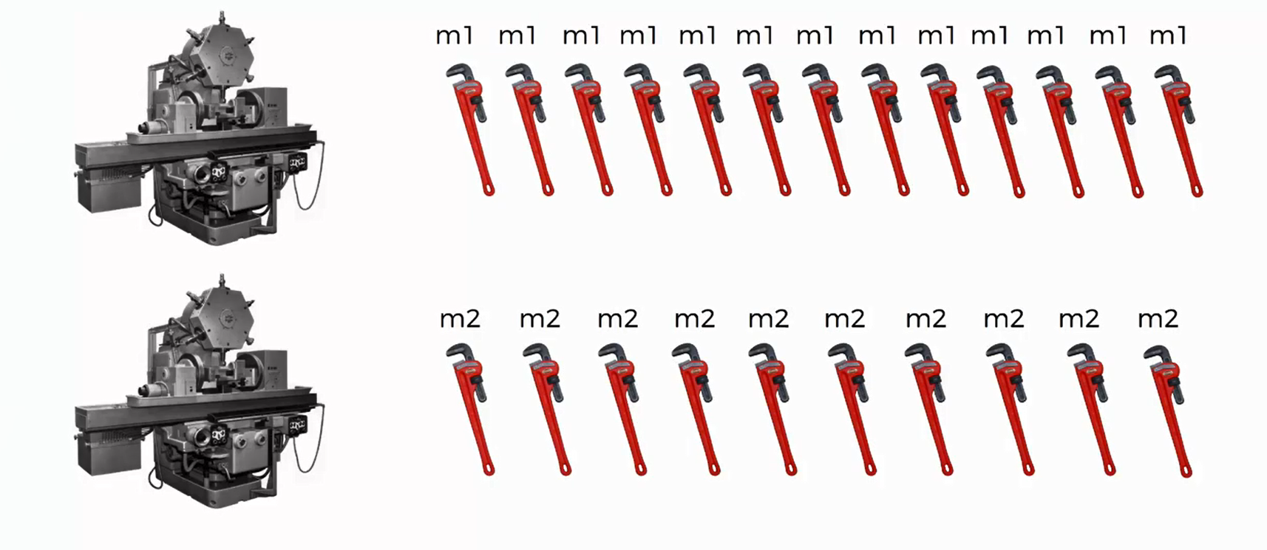
Bayes Rule
each wrench is labeled according to the machine which produced it

Slide 12
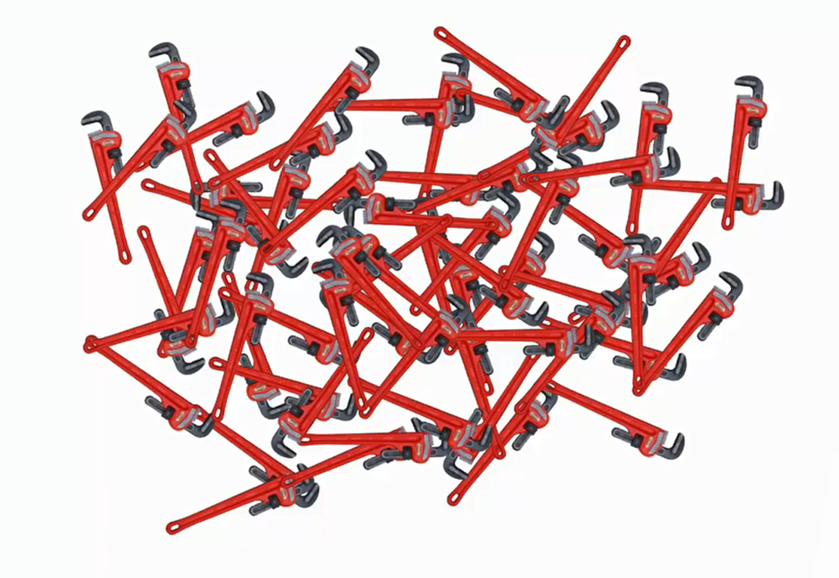
Bayes Rule
all the wrenches produced in an hour

Slide 13
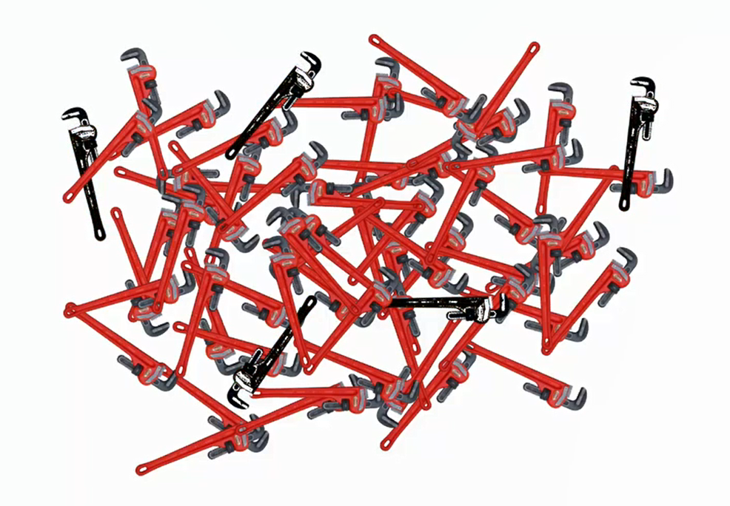
Bayes Rule
there are some defective ones as well

Slide 14
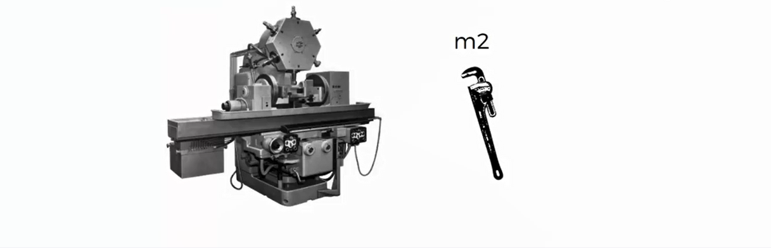
Bayes Rule
What’s the probability that a wrench produced by machine 2 is defective?
lets say we need to estimate this probability

Slide 15
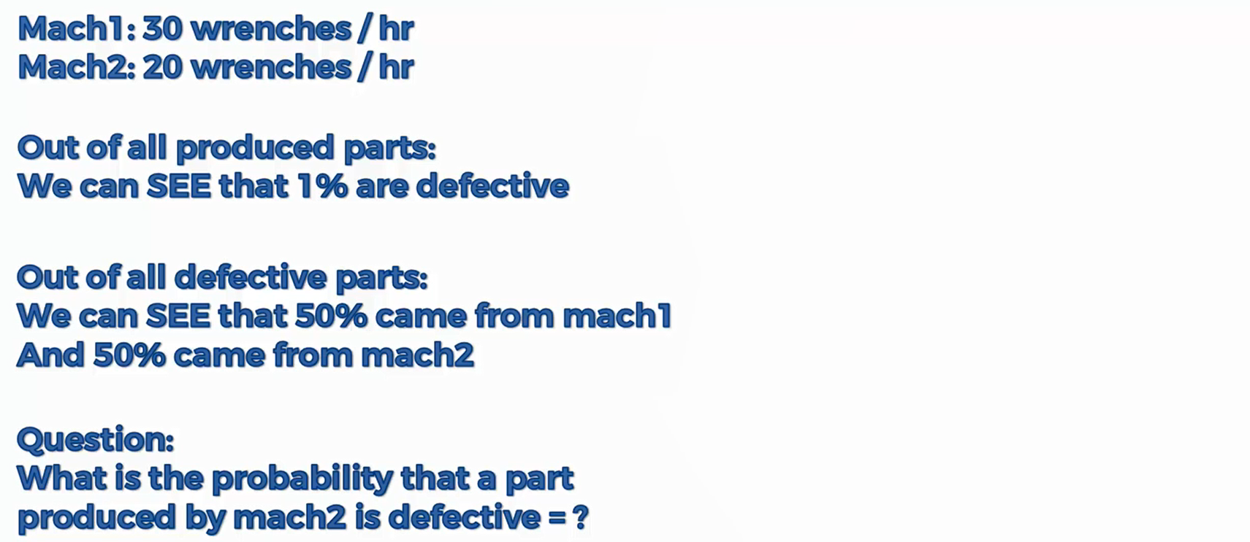
Bayes Rule
some prior information is available

Slide 16
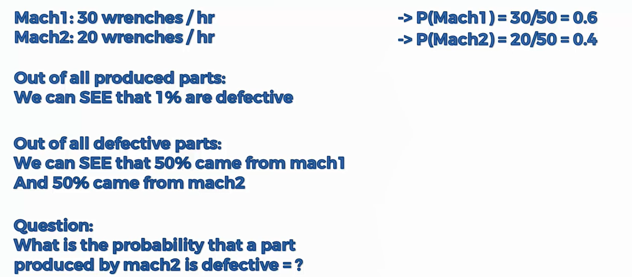
Bayes Rule
some prior information is available

Slide 17
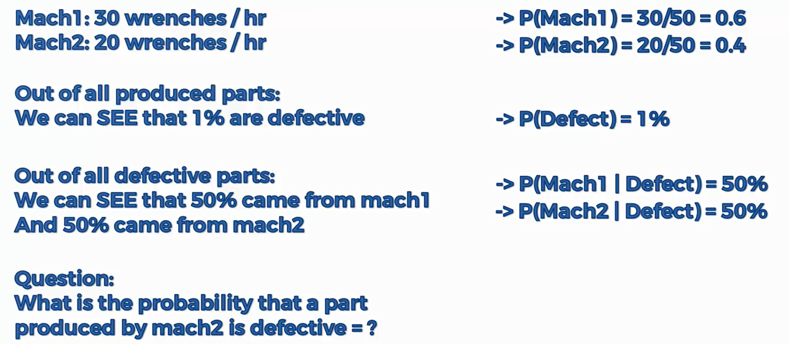
Bayes Rule
some prior information is available

Slide 18
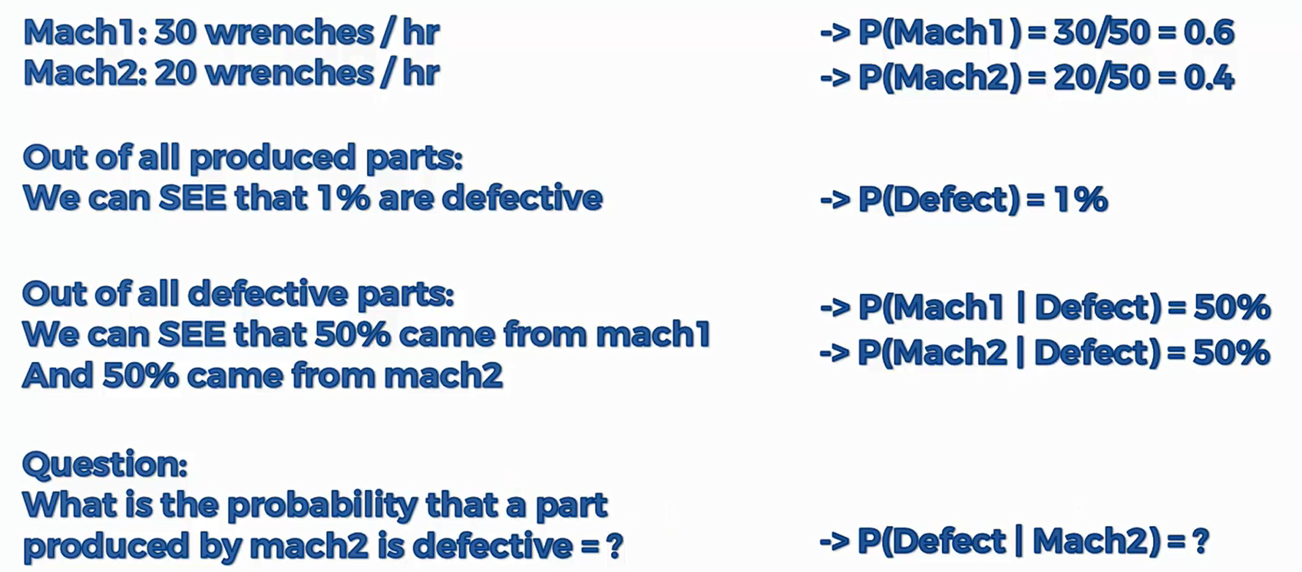
Bayes Rule
some prior information is available

Slide 19
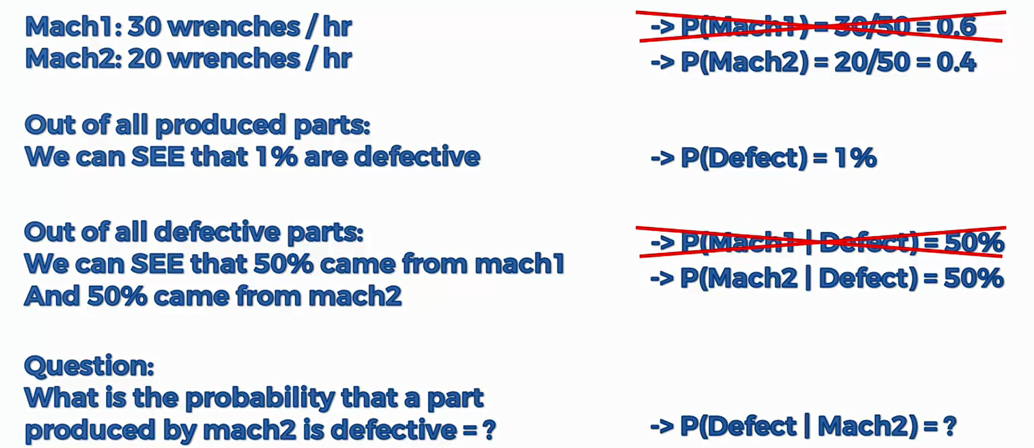
Bayes Rule

Slide 20
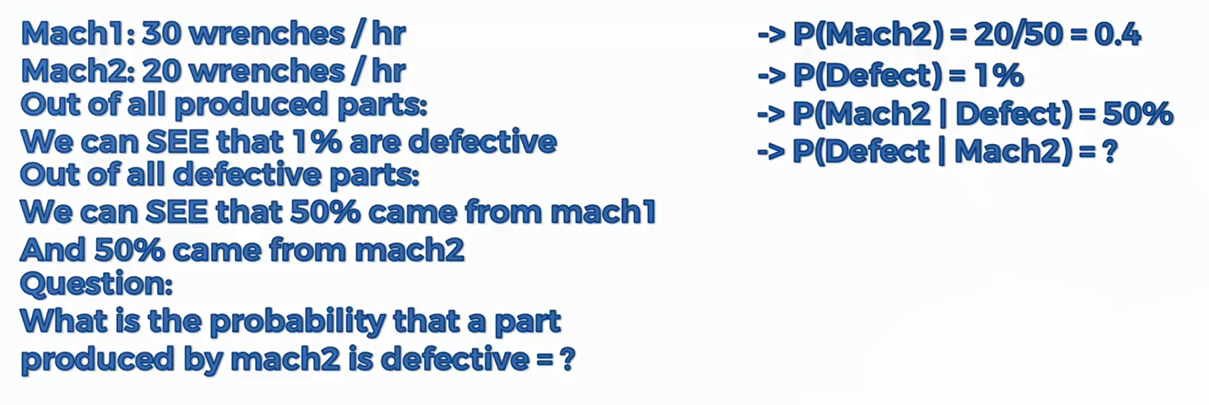
Bayes Rule

Slide 21
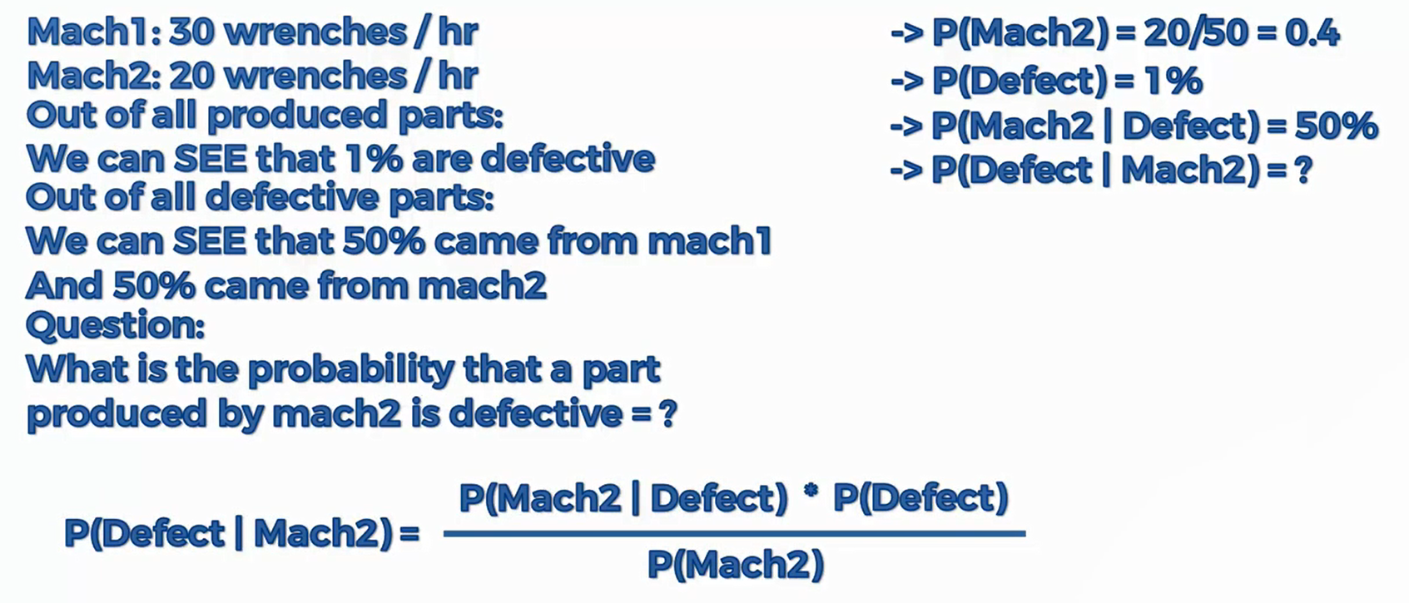
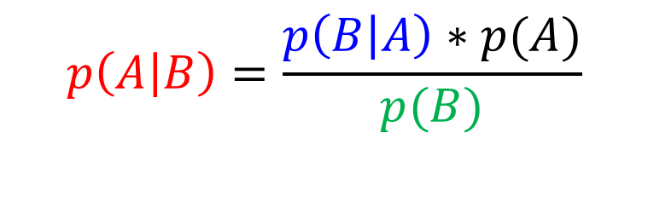
Bayes Rule
$$p\left(A | B\right)=\frac{p\left(B | A\right)∗p(A)}{p(B)}$$

Slide 22
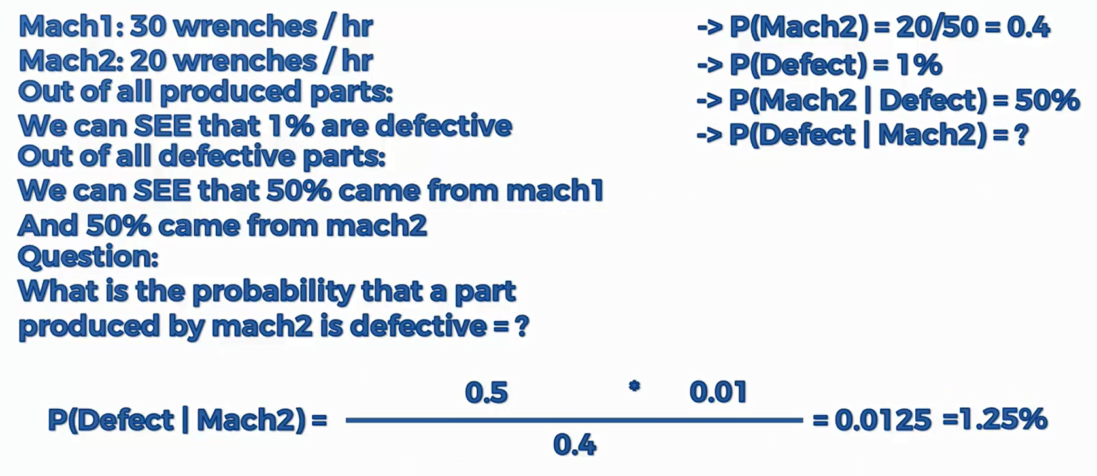
Bayes Rule
$$p\left(A | B\right)=\frac{p\left(B | A\right)∗p(A)}{p(B)}$$

Slide 23
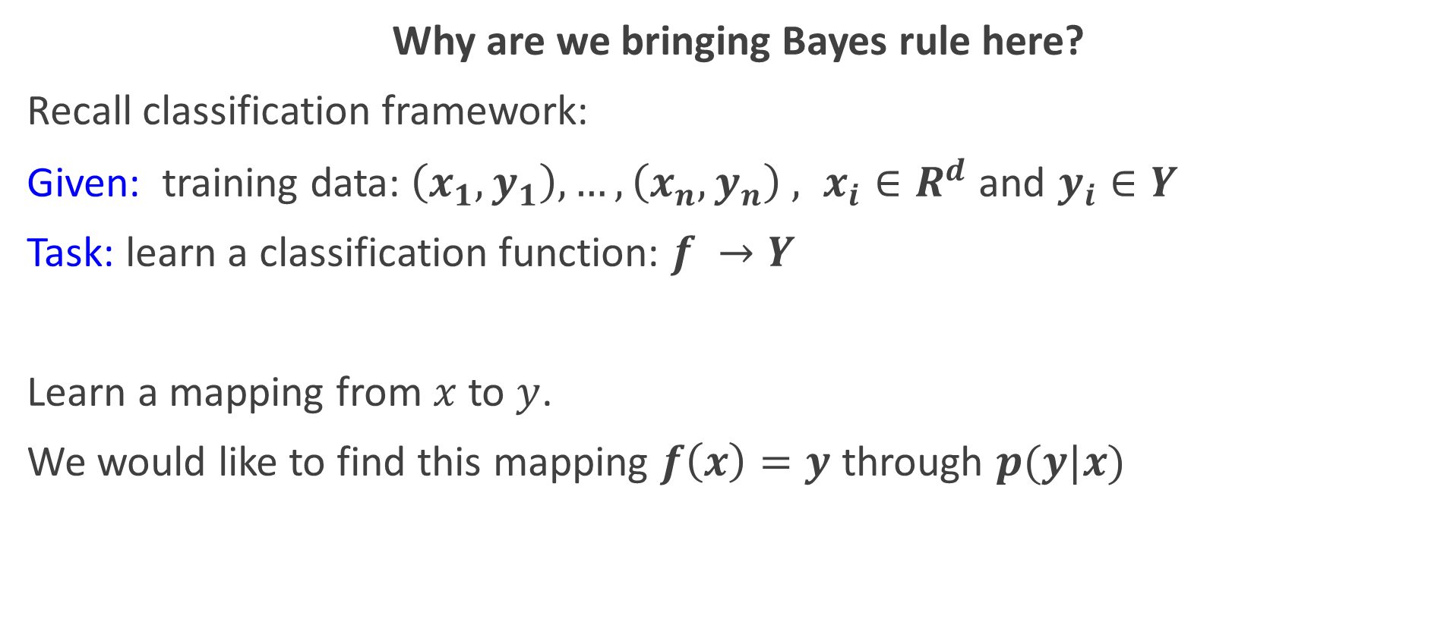
Why probabilities
Why are we bringing Bayes rule here?
Recall classification framework:
Given: training data:$\left(x_{1},y_{1}\right),…,\left(x_{n},y_{n}\right) , x_{i}∈R^{d}$and $y_{i}∈Y$
Task: learn a classification function: $f →Y$
Learn a mapping from $x$ to $y$.
We would like to find this mapping $f\left(x\right)=y$ through $p(y|x)$

Slide 24
Naïve Bayes Classifier
Probabilistic model
Highly practical method
Frequently used for working with natural language text documents
Naïve because of strong independence assumption it makes

Slide 25
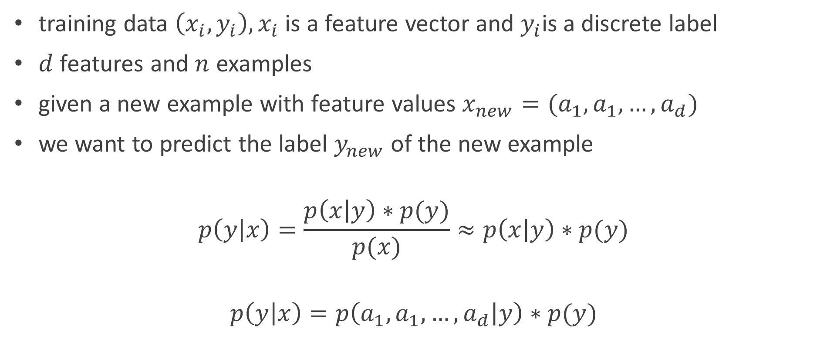
Setting
training data $\left(x_{i},y_{i}\right), x_{i}$ is a feature vector and $y_{i}$is a discrete label
$d$ features and $n$ examples
given a new example with feature values $x_{new}=(a_{1},a_{1},…,a_{d})$
we want to predict the label $y_{new}$ of the new example
$$p\left(y | x\right)=\frac{p\left(x | y\right)∗p(y)}{p(x)}≈p\left(x | y\right)∗p(y)$$
$$p\left(y | x\right)=p\left(a_{1},a_{1},…,a_{d} | y\right)∗p(y)$$

Slide 26
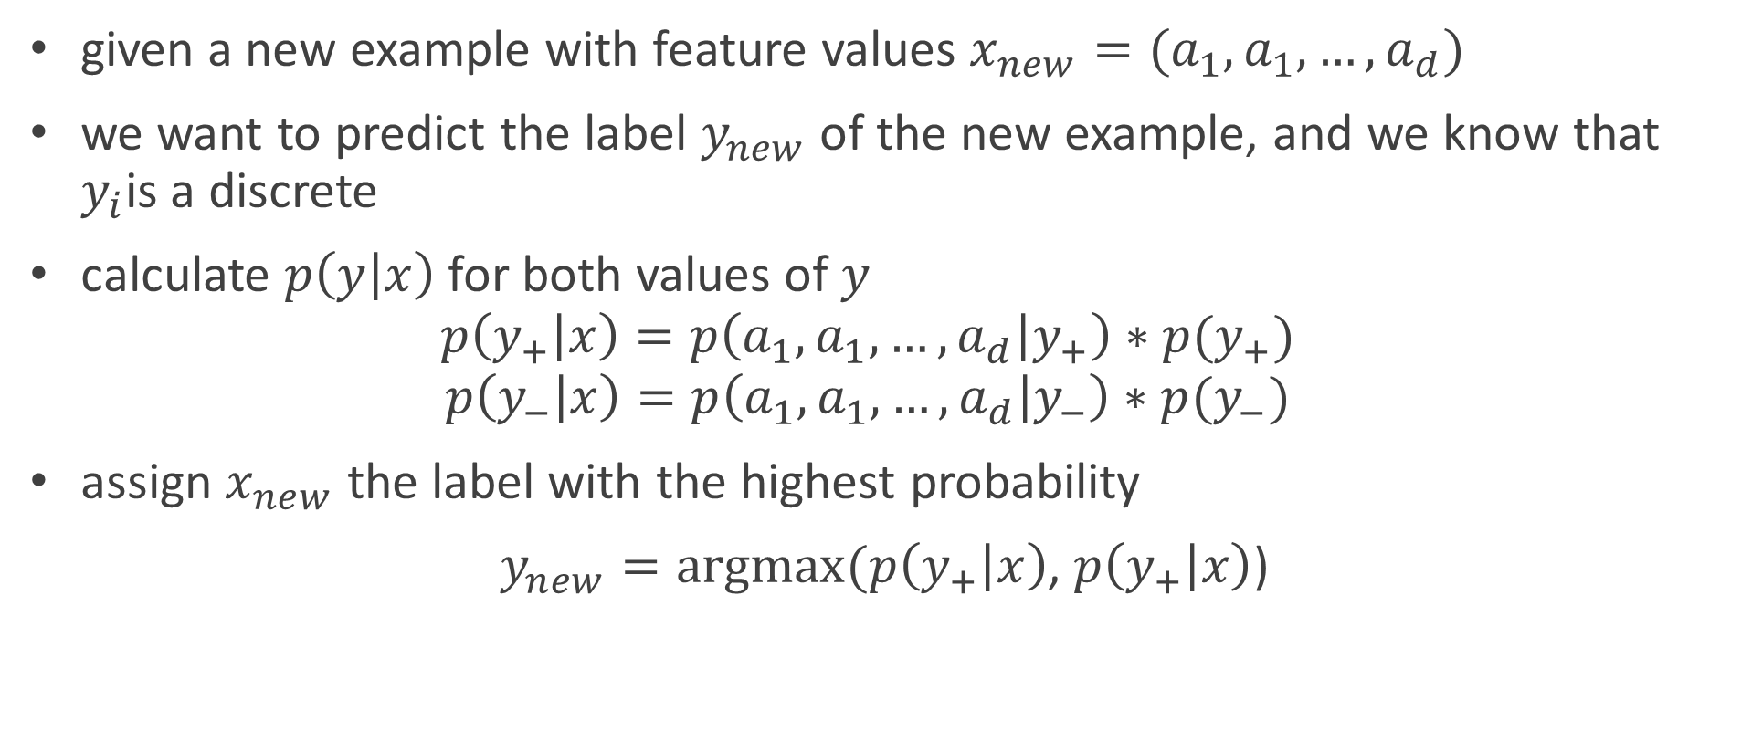
Setting
given a new example with feature values $x_{new}=(a_{1},a_{1},…,a_{d})$
we want to predict the label $y_{new}$ of the new example, and we know that $y_{i}$is a discrete
calculate $p\left(y | x\right)$ for both values of $y$
$$p\left(y_{+} | x\right)=p\left(a_{1},a_{1},…,a_{d} | y_{+}\right)∗p(y_{+})$$
$$p\left(y_{−} | x\right)=p\left(a_{1},a_{1},…,a_{d} | y_{−}\right)∗p(y_{−})$$
assign $x_{new}$ the label with the highest probability
$y_{new}=argmax⁡(p\left(y_{+} | x\right)$, $p\left(y_{+} | x\right)$)

Slide 27
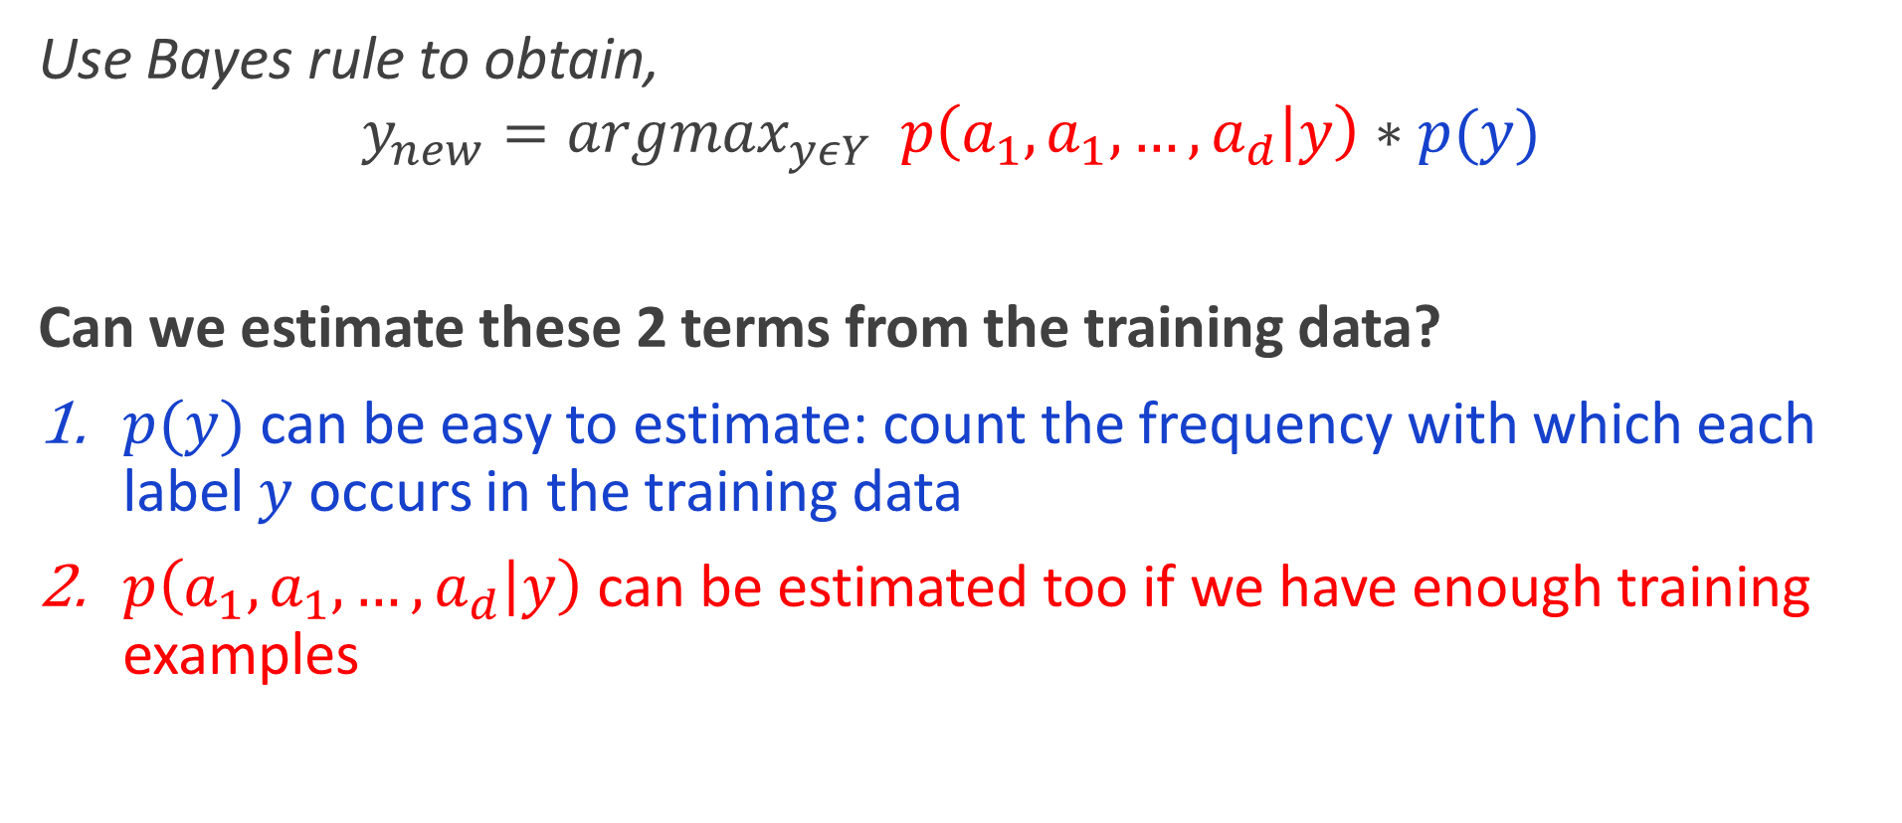
Setting
Use Bayes rule to obtain,
$$y_{new}={argmax}_{yεY} p\left(a_{1},a_{1},…,a_{d} | y\right)∗p(y)$$
Can we estimate these 2 terms from the training data?
$p(y)$ can be easy to estimate: count the frequency with which each label $y$ occurs in the training data
$p\left(a_{1},a_{1},…,a_{d} | y\right)$ can be estimated too if we have enough training examples

Slide 28
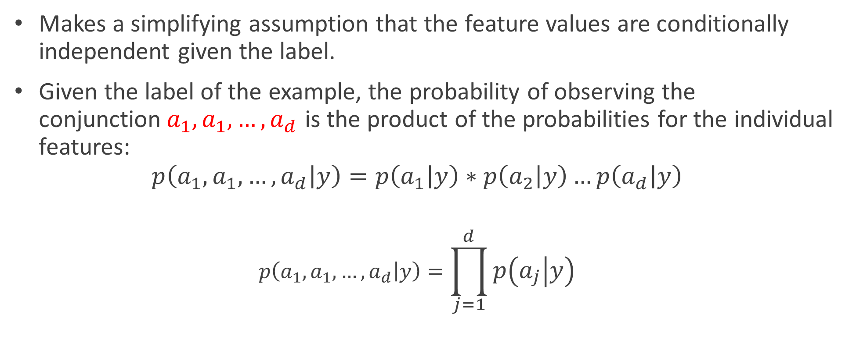
Naïve Bayes Classifier
Makes a simplifying assumption that the feature values are conditionally independent given the label.
Given the label of the example, the probability of observing the conjunction${ a}_{1},a_{1},…,a_{d}$ is the product of the probabilities for the individual features:
$$p\left(a_{1},a_{1},…,a_{d} | y\right)=p\left(a_{1} | y\right)∗p\left(a_{2} | y\right)…p\left(a_{d} | y\right)$$
$$p\left(a_{1},a_{1},…,a_{d} | y\right)=\prod_{j=1}^{d}{p\left(a_{j} | y\right)}$$

Slide 29
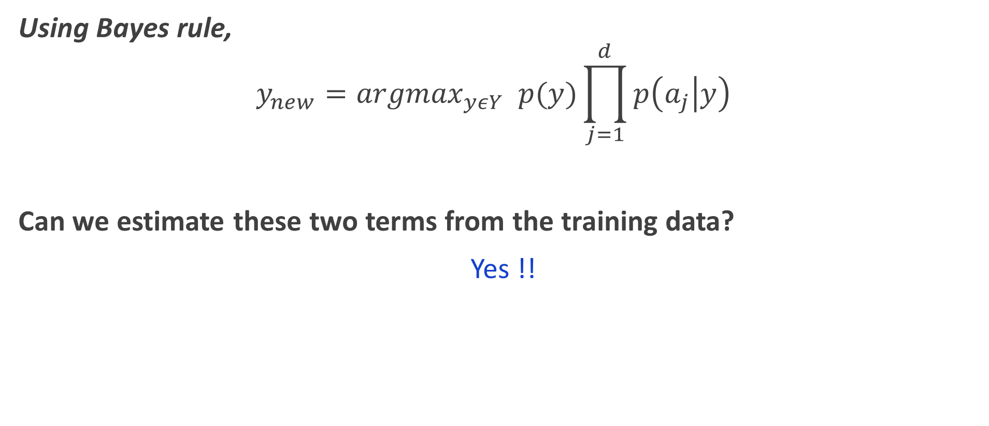
Naïve Bayes Classifier
Using Bayes rule,
$$y_{new}={argmax}_{yεY} p(y)\prod_{j=1}^{d}{p\left(a_{j} | y\right)}$$
Can we estimate these two terms from the training data?
Yes !!

Slide 30
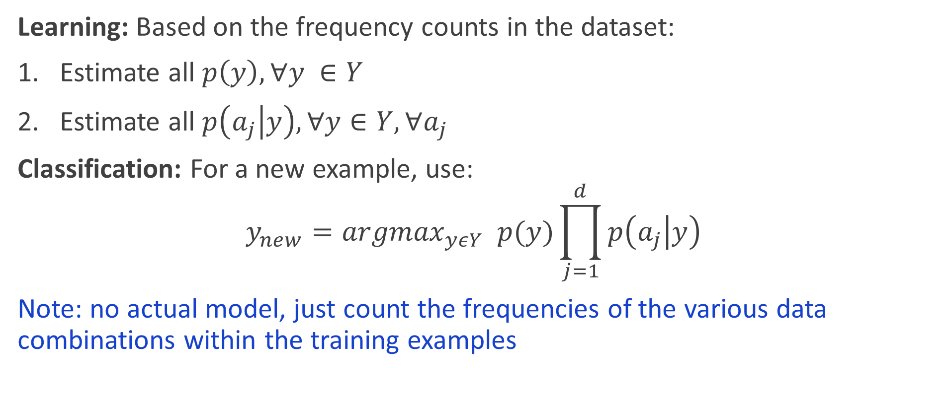
Algorithm
Learning: Based on the frequency counts in the dataset:
Estimate all $p\left(y\right), ∀y ∈Y$
Estimate all $p\left(a_{j} | y\right), ∀y∈Y, ∀a_{j}$
Classification: For a new example, use:
$$y_{new}={argmax}_{yεY} p(y)\prod_{j=1}^{d}{p\left(a_{j} | y\right)}$$
Note: no actual model, just count the frequencies of the various data combinations within the training examples

Slide 31
Example
Highest Degree | Work experience | Favorite Language | Needs Work Visa | Hire
Bachelors | Mobile Dev | Objective-C | TRUE | Yes
Masters | Web Dev | Java | FALSE | Yes
Masters | Mobile Dev | Java | TRUE | Yes
PhD | Mobile Dev | Objective-C | TRUE | Yes
PhD | Web Dev | Objective-C | TRUE | No
Bachelors | UX Design | Objective-C | TRUE | No
Bachelors | Mobile Dev | Java | FALSE | Yes
PhD | Web Dev | Objective-C | FALSE | No
Bachelors | UX Design | Java | FALSE | Yes
Masters | UX Design | Objective-C | TRUE | No
Masters | UX Design | Java | FALSE | Yes
PhD | Mobile Dev | Java | FALSE | No
Masters | Mobile Dev | Java | TRUE | Yes
Bachelors | Web Dev | Objective-C | FALSE | No
Masters | UX Design | Java | TRUE | ??

Slide 32
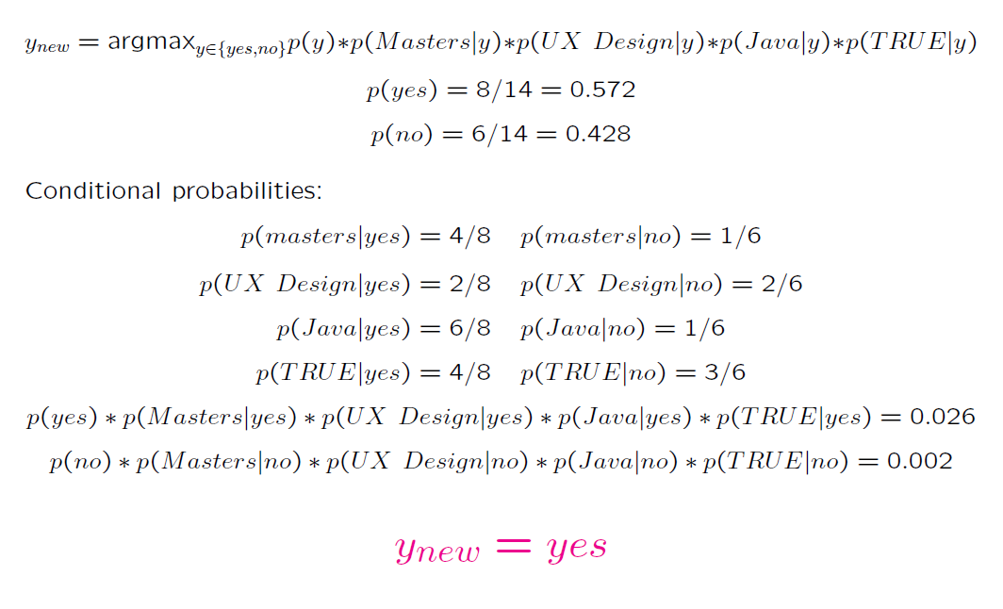
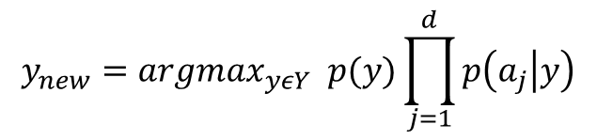
Example
$$y_{new}={argmax}_{yεY} p(y)\prod_{j=1}^{d}{p\left(a_{j} | y\right)}$$
Highest Degree | Work experience | Favorite Language | Needs Work Visa | Hire
Bachelors | Mobile Dev | Objective-C | TRUE | Yes
Masters | Web Dev | Java | FALSE | Yes
Masters | Mobile Dev | Java | TRUE | Yes
PhD | Mobile Dev | Objective-C | TRUE | Yes
PhD | Web Dev | Objective-C | TRUE | No
Bachelors | UX Design | Objective-C | TRUE | No
Bachelors | Mobile Dev | Java | FALSE | Yes
PhD | Web Dev | Objective-C | FALSE | No
Bachelors | UX Design | Java | FALSE | Yes
Masters | UX Design | Objective-C | TRUE | No
Masters | UX Design | Java | FALSE | Yes
PhD | Mobile Dev | Java | FALSE | No
Masters | Mobile Dev | Java | TRUE | Yes
Bachelors | Web Dev | Objective-C | FALSE | No
Masters | UX Design | Java | TRUE | ??

Slide 33
Example
$$y_{new}={argmax}_{yεY} p(y)\prod_{j=1}^{d}{p\left(a_{j} | y\right)}$$
Highest Degree | Work experience | Favorite Language | Needs Work Visa | Hire
Bachelors | Mobile Dev | Objective-C | TRUE | Yes
Masters | Web Dev | Java | FALSE | Yes
Masters | Mobile Dev | Java | TRUE | Yes
PhD | Mobile Dev | Objective-C | TRUE | Yes
PhD | Web Dev | Objective-C | TRUE | No
Bachelors | UX Design | Objective-C | TRUE | No
Bachelors | Mobile Dev | Java | FALSE | Yes
PhD | Web Dev | Objective-C | FALSE | No
Bachelors | UX Design | Java | FALSE | Yes
Masters | UX Design | Objective-C | TRUE | No
Masters | UX Design | Java | FALSE | Yes
PhD | Mobile Dev | Java | FALSE | No
Masters | Mobile Dev | Java | TRUE | Yes
Bachelors | Web Dev | Objective-C | FALSE | No
Masters | UX Design | Java | TRUE | ??

Slide 34
Example
$$y_{new}={argmax}_{yεY} p(y)\prod_{j=1}^{d}{p\left(a_{j} | y\right)}$$
Highest Degree | Work experience | Favorite Language | Needs Work Visa | Hire
Bachelors | Mobile Dev | Objective-C | TRUE | Yes
Masters | Web Dev | Java | FALSE | Yes
Masters | Mobile Dev | Java | TRUE | Yes
PhD | Mobile Dev | Objective-C | TRUE | Yes
PhD | Web Dev | Objective-C | TRUE | No
Bachelors | UX Design | Objective-C | TRUE | No
Bachelors | Mobile Dev | Java | FALSE | Yes
PhD | Web Dev | Objective-C | FALSE | No
Bachelors | UX Design | Java | FALSE | Yes
Masters | UX Design | Objective-C | TRUE | No
Masters | UX Design | Java | FALSE | Yes
PhD | Mobile Dev | Java | FALSE | No
Masters | Mobile Dev | Java | TRUE | Yes
Bachelors | Web Dev | Objective-C | FALSE | No
Masters | UX Design | Java | TRUE | ??

Slide 35
Example
$$y_{new}={argmax}_{yεY} p(y)\prod_{j=1}^{d}{p\left(a_{j} | y\right)}$$
Highest Degree | Work experience | Favorite Language | Needs Work Visa | Hire
Bachelors | Mobile Dev | Objective-C | TRUE | Yes
Masters | Web Dev | Java | FALSE | Yes
Masters | Mobile Dev | Java | TRUE | Yes
PhD | Mobile Dev | Objective-C | TRUE | Yes
PhD | Web Dev | Objective-C | TRUE | No
Bachelors | UX Design | Objective-C | TRUE | No
Bachelors | Mobile Dev | Java | FALSE | Yes
PhD | Web Dev | Objective-C | FALSE | No
Bachelors | UX Design | Java | FALSE | Yes
Masters | UX Design | Objective-C | TRUE | No
Masters | UX Design | Java | FALSE | Yes
PhD | Mobile Dev | Java | FALSE | No
Masters | Mobile Dev | Java | TRUE | Yes
Bachelors | Web Dev | Objective-C | FALSE | No
Masters | UX Design | Java | TRUE | ??

Slide 36
Example
$$y_{new}={argmax}_{yεY} p(y)\prod_{j=1}^{d}{p\left(a_{j} | y\right)}$$
Highest Degree | Work experience | Favorite Language | Needs Work Visa | Hire
Bachelors | Mobile Dev | Objective-C | TRUE | Yes
Masters | Web Dev | Java | FALSE | Yes
Masters | Mobile Dev | Java | TRUE | Yes
PhD | Mobile Dev | Objective-C | TRUE | Yes
PhD | Web Dev | Objective-C | TRUE | No
Bachelors | UX Design | Objective-C | TRUE | No
Bachelors | Mobile Dev | Java | FALSE | Yes
PhD | Web Dev | Objective-C | FALSE | No
Bachelors | UX Design | Java | FALSE | Yes
Masters | UX Design | Objective-C | TRUE | No
Masters | UX Design | Java | FALSE | Yes
PhD | Mobile Dev | Java | FALSE | No
Masters | Mobile Dev | Java | TRUE | Yes
Bachelors | Web Dev | Objective-C | FALSE | No
Masters | UX Design | Java | TRUE | ??

Slide 37
Example
$$y_{new}={argmax}_{yεY} p(y)\prod_{j=1}^{d}{p\left(a_{j} | y\right)}$$
Highest Degree | Work experience | Favorite Language | Needs Work Visa | Hire
Bachelors | Mobile Dev | Objective-C | TRUE | Yes
Masters | Web Dev | Java | FALSE | Yes
Masters | Mobile Dev | Java | TRUE | Yes
PhD | Mobile Dev | Objective-C | TRUE | Yes
PhD | Web Dev | Objective-C | TRUE | No
Bachelors | UX Design | Objective-C | TRUE | No
Bachelors | Mobile Dev | Java | FALSE | Yes
PhD | Web Dev | Objective-C | FALSE | No
Bachelors | UX Design | Java | FALSE | Yes
Masters | UX Design | Objective-C | TRUE | No
Masters | UX Design | Java | FALSE | Yes
PhD | Mobile Dev | Java | FALSE | No
Masters | Mobile Dev | Java | TRUE | Yes
Bachelors | Web Dev | Objective-C | FALSE | No
Masters | UX Design | Java | TRUE | ??

Slide 38
Example
$$y_{new}={argmax}_{yεY} p(y)\prod_{j=1}^{d}{p\left(a_{j} | y\right)}$$
Highest Degree | Work experience | Favorite Language | Needs Work Visa | Hire
Bachelors | Mobile Dev | Objective-C | TRUE | Yes
Masters | Web Dev | Java | FALSE | Yes
Masters | Mobile Dev | Java | TRUE | Yes
PhD | Mobile Dev | Objective-C | TRUE | Yes
PhD | Web Dev | Objective-C | TRUE | No
Bachelors | UX Design | Objective-C | TRUE | No
Bachelors | Mobile Dev | Java | FALSE | Yes
PhD | Web Dev | Objective-C | FALSE | No
Bachelors | UX Design | Java | FALSE | Yes
Masters | UX Design | Objective-C | TRUE | No
Masters | UX Design | Java | FALSE | Yes
PhD | Mobile Dev | Java | FALSE | No
Masters | Mobile Dev | Java | TRUE | Yes
Bachelors | Web Dev | Objective-C | FALSE | No
Masters | UX Design | Java | TRUE | Yes

Slide 39
NLP
is a field of artificial intelligence (AI) focusing on enabling machines to understand, interpret, and respond to human language in a meaningful way.
bridging the gap between human communication (natural language) and machine understanding (structured data).
combines computational linguistics with machine learning and deep learning to analyze and process large volumes of natural language data.

Slide 40
Splitting a sentence into words or subwords.
Example:
Input: "I love AI."
Output: ["I", "love", “AI"]
Named Entity Recognition (NER)
Identifying entities like names, dates, organizations, or locations in text.
Example: In “Ram studies AI at Islington," “Ram" is a person, and “Islington" is an organization.
Machine Translation
Translating text from one language to another.
Example: Google Translate.

Slide 41
Text classification
Learning to classify text. Why?
Learn which news articles are of interest
Learn to classify web pages by topic
Classify spam from non spam emails
Naïve Bayes is among the most effective algorithms
What attributes shall we use to represent text documents?

Slide 42
Text classification
A common way to represent text is by using the bag of words approach
It was the best of times
it was the worst of times
it was the age of wisdom
it was the age of foolishness
unique words ignoring case and punctuation
vocabulary
“it”, “was”, “the”, “best”, “of”, “times”, “worst”, “age”, “wisdom”, “foolishness”
it | was | the | best | of | times | worst | age | wisdom | foolishness
1 | 1 | 1 | 1 | 1 | 1 | 0 | 0 | 0 | 0
1 | 1 | 1 | 0 | 1 | 1 | 1 | 0 | 0 | 0
1 | 1 | 1 | 0 | 1 | 0 | 0 | 1 | 1 | 0
1 | 1 | 1 | 0 | 1 | 0 | 0 | 1 | 0 | 1
It was the best of times
it was the worst of times
it was the age of wisdom
it was the age of foolishness

Slide 43
Text classification
A common way to represent text is by using the bag of words approach
I loved the movie | +
I hated the movie | -
a great movie. good movie | +
poor acting | -
great acting, a great movie | +
unique words ignoring case and punctuation
vocabulary
“I”, “loved”, “the”, “movie”, “hated”, “a”, “great”, “poor”, “acting”, “good”
I | loved | the | movie | hated | a | great | poor | acting | good | label
1 | 1 | 1 | 1 | 0 | 0 | 0 | 0 | 0 | 0 | +
1 | 0 | 1 | 1 | 1 | 0 | 0 | 0 | 0 | 0 | -
0 | 0 | 0 | 2 | 0 | 1 | 1 | 0 | 0 | 1 | +
0 | 0 | 0 | 0 | 0 | 0 | 0 | 1 | 1 | 0 | -
0 | 0 | 0 | 1 | 0 | 1 | 2 | 0 | 1 | 0 | +
I loved the movie
I hated the movie
a great movie. good movie
poor acting
great acting, a great movie

Slide 44
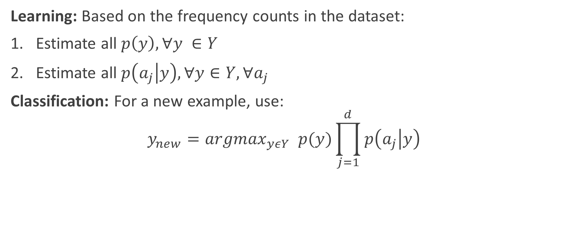
Algorithm
Learning: Based on the frequency counts in the dataset:
Estimate all $p\left(y\right), ∀y ∈Y$
Estimate all $p\left(a_{j} | y\right), ∀y∈Y, ∀a_{j}$
Classification: For a new example, use:
$$y_{new}={argmax}_{yεY} p(y)\prod_{j=1}^{d}{p\left(a_{j} | y\right)}$$

Slide 45
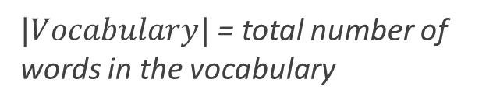
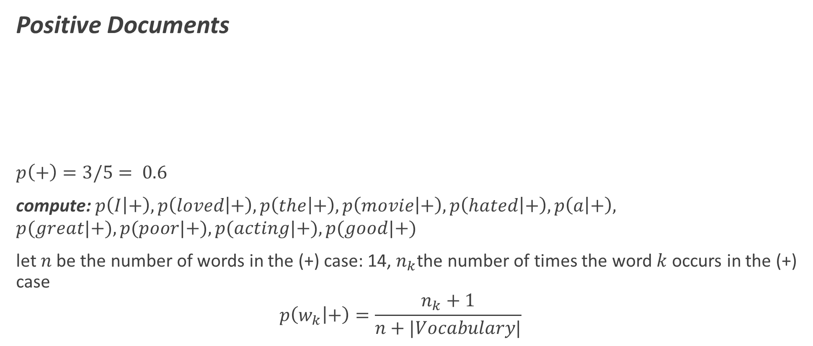
Text classification
Positive Documents
$$p\left(+\right)=3/5= 0.6$$
compute: $p\left(I | +\right), p\left(loved | +\right), p\left(the | +\right), p\left(movie | +\right), p\left(hated | +\right), p\left(a | +\right),$
$$p(great|+), p(poor|+), p(acting|+), p(good|+)$$
let $n$be the number of words in the (+) case: 14, $n_{k}$the number of times the word $k$occurs in the (+) case
$$p\left(w_{k} | +\right)=\frac{n_{k}+1}{n+|Vocabulary|}$$
I | loved | the | movie | hated | a | great | poor | acting | good | label
1 | 1 | 1 | 1 | 0 | 0 | 0 | 0 | 0 | 0 | +
0 | 0 | 0 | 2 | 0 | 1 | 1 | 0 | 0 | 1 | +
0 | 0 | 0 | 1 | 0 | 1 | 2 | 0 | 1 | 0 | +
I loved the movie
a great movie. good movie
great acting, a great movie
$|Vocabulary|$ = total number of words in the vocabulary

Slide 46
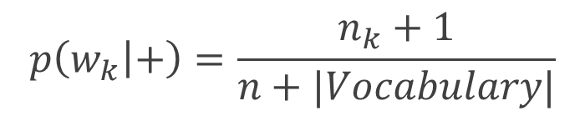
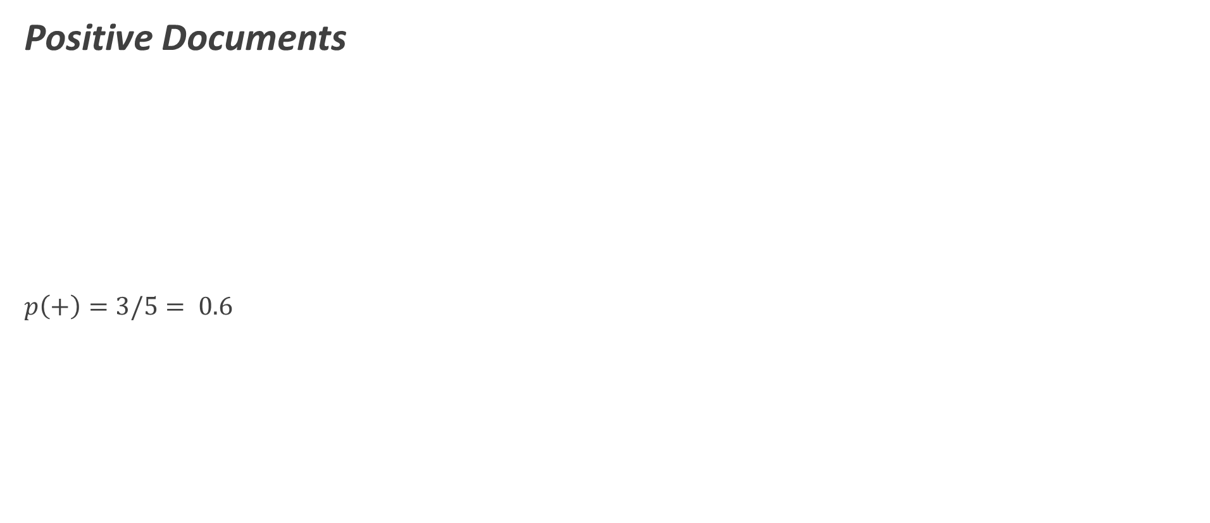
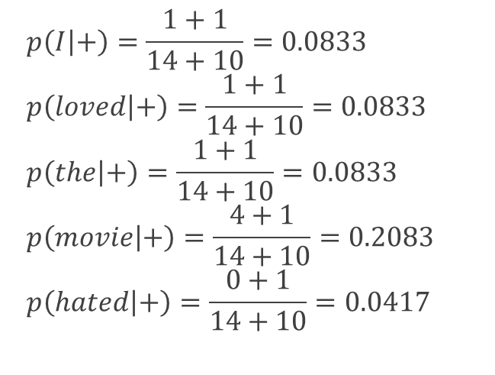
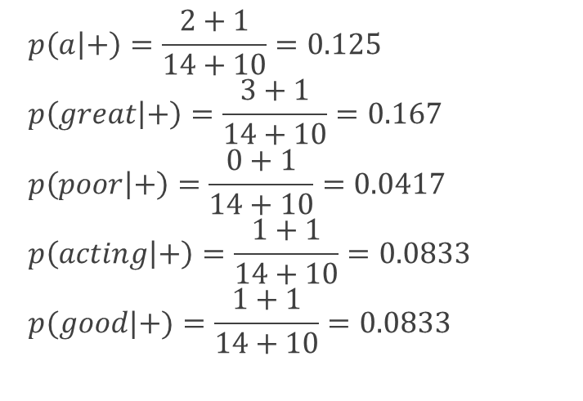
Text classification
$$p\left(w_{k} | +\right)=\frac{n_{k}+1}{n+|Vocabulary|}$$
Positive Documents
$$p\left(+\right)=3/5= 0.6$$
I | loved | the | movie | hated | a | great | poor | acting | good | label
1 | 1 | 1 | 1 | 0 | 0 | 0 | 0 | 0 | 0 | +
0 | 0 | 0 | 2 | 0 | 1 | 1 | 0 | 0 | 1 | +
0 | 0 | 0 | 1 | 0 | 1 | 2 | 0 | 1 | 0 | +
I loved the movie
a great movie. good movie
great acting, a great movie
$$p\left(I | +\right)=\frac{1+1}{14+10}=0.0833$$
$$p\left(loved | +\right)=\frac{1+1}{14+10}=0.0833$$
$$p\left(the | +\right)=\frac{1+1}{14+10}=0.0833$$
$$p\left(movie | +\right)=\frac{4+1}{14+10}=0.2083$$
$$p\left(hated | +\right)=\frac{0+1}{14+10}=0.0417$$
$$p\left(a | +\right)=\frac{2+1}{14+10}=0.125$$
$$p\left(great | +\right)=\frac{3+1}{14+10}=0.167$$
$$p\left(poor | +\right)=\frac{0+1}{14+10}=0.0417$$
$$p\left(acting | +\right)=\frac{1+1}{14+10}=0.0833$$
$$p(good|+)=\frac{1+1}{14+10}=0.0833$$

Slide 47
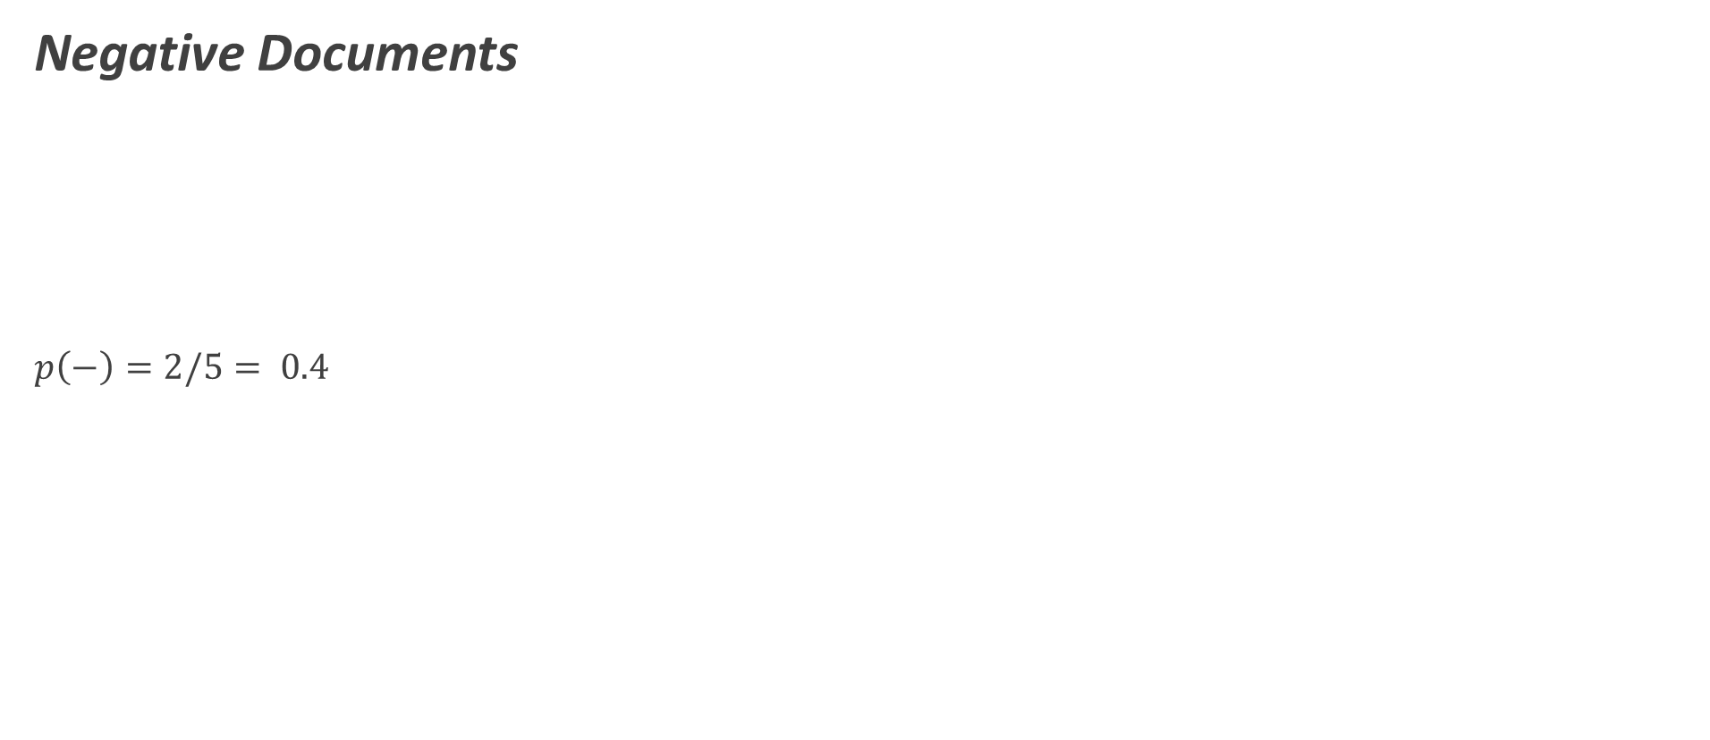
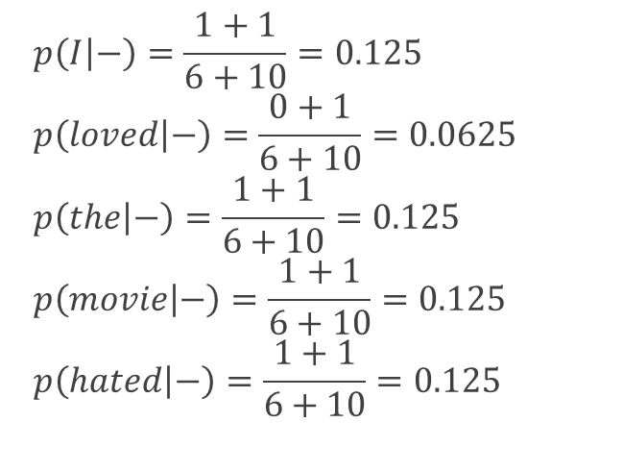
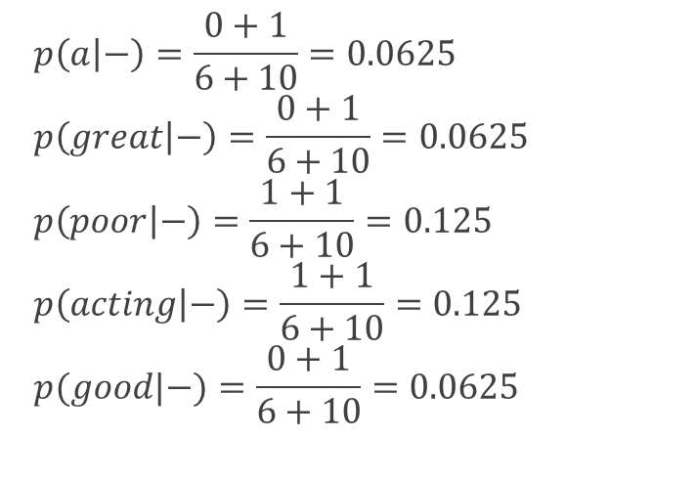
Text classification
$$p\left(w_{k} | +\right)=\frac{n_{k}+1}{n+|Vocabulary|}$$
Negative Documents
$$p\left(−\right)=2/5= 0.4$$
I | loved | the | movie | hated | a | great | poor | acting | good | label
1 | 0 | 1 | 1 | 1 | 0 | 0 | 0 | 0 | 0 | -
0 | 0 | 0 | 0 | 0 | 0 | 0 | 1 | 1 | 0 | -
I hated the movie
poor acting
$$p\left(I | −\right)=\frac{1+1}{6+10}=0.125$$
$$p\left(loved | −\right)=\frac{0+1}{6+10}=0.0625$$
$$p\left(the | −\right)=\frac{1+1}{6+10}=0.125$$
$$p\left(movie | −\right)=\frac{1+1}{6+10}=0.125$$
$$p\left(hated | −\right)=\frac{1+1}{6+10}=0.125$$
$$p\left(a | −\right)=\frac{0+1}{6+10}=0.0625$$
$$p\left(great | −\right)=\frac{0+1}{6+10}=0.0625$$
$$p\left(poor | −\right)=\frac{1+1}{6+10}=0.125$$
$$p\left(acting | −\right)=\frac{1+1}{6+10}=0.125$$
$$p(good|−)=\frac{0+1}{6+10}=0.0625$$

Slide 48
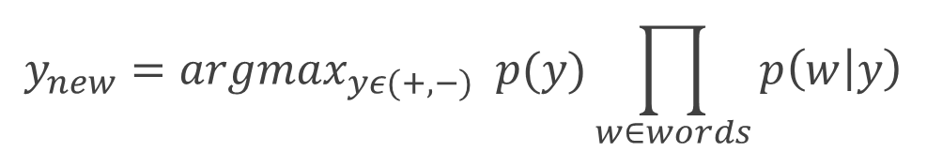
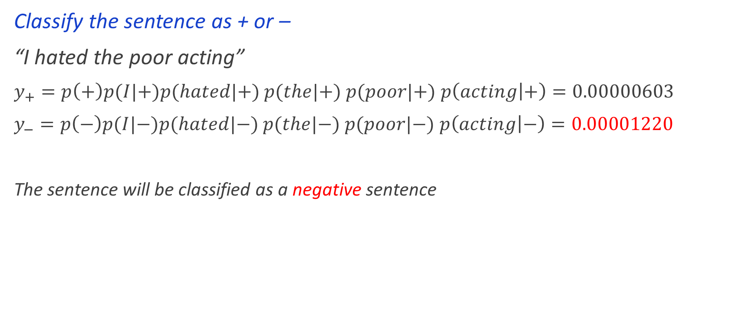
Text classification
$$y_{new}={argmax}_{yε(+,−)} p(y)\prod_{w∈words}{p\left(w | y\right)}$$
Classify the sentence as + or –
“I hated the poor acting”
$y_{+}=p\left(+\right)p(I|+)p(hated|+)$ $p(the|+)$ $p(poor|+)$ $p\left(acting | +\right)=0.00000603$
$y_{−}=p\left(−\right)p(I|−)p(hated|−)$ $p(the|−)$ $p(poor|−)$ $p\left(acting | −\right)=0.00001220$
The sentence will be classified as a negative sentence

Slide 49
Summary
Naïve Bayes is a probabilistic model
Incredibly simple and easy to implement
Works wonderful for text (Natural Language Processing)

Slide 50
End of Lecture 6

Slide 51
Thank you ! Any questions ?

